Slide 1



FORAGE VIRTUAL WORK EXPERICE PROGRAM
BRITISH
AIRWAYS
Predictive Analysis
START

Slide 2
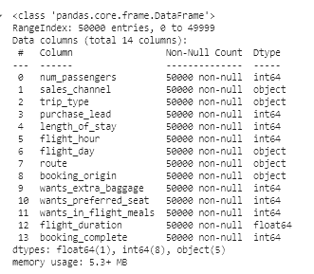
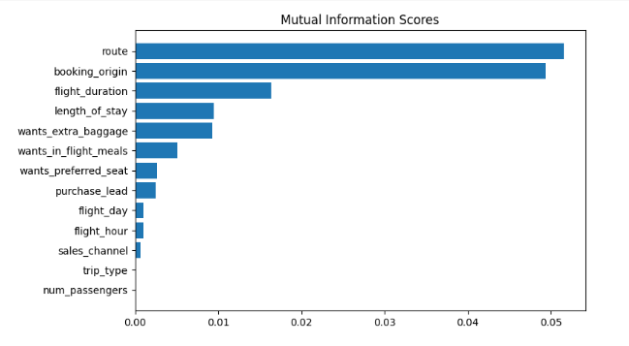
5 Feature with the highest Mutual Information Scores is Route, booking_origin, flight_duration, length_of_stay, and wants_extra_baggage

Slide 3
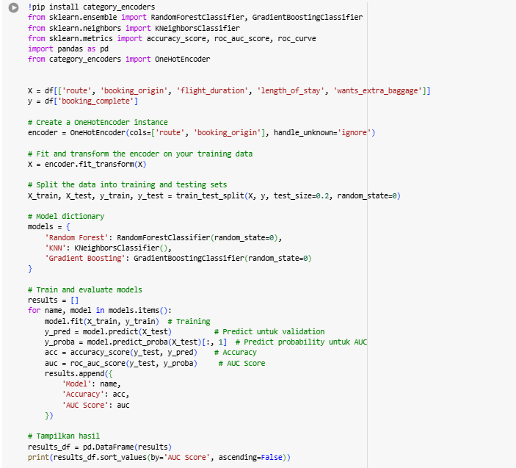
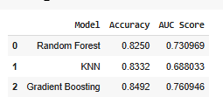
MODEL DEVELOPMENT
Gradient Boosting is the Highest Accuracy Model with a score of 0.8492

Slide 4
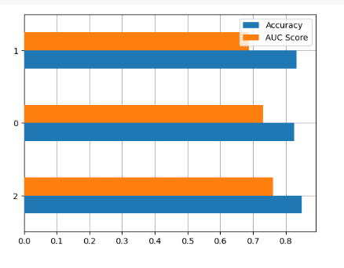
MODEL COMPARISON
KNN
Random Forest
Gradient Boosting

